Slide 1
Hotel Reservation
File created on: 1/2/2024 3:46:53 PM

Slide 2
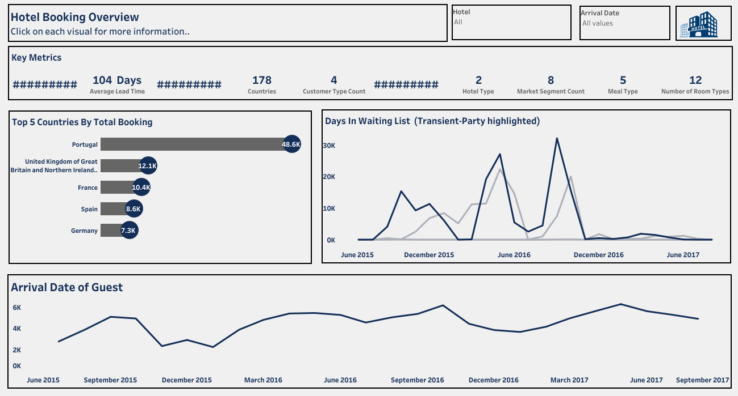

Slide 3
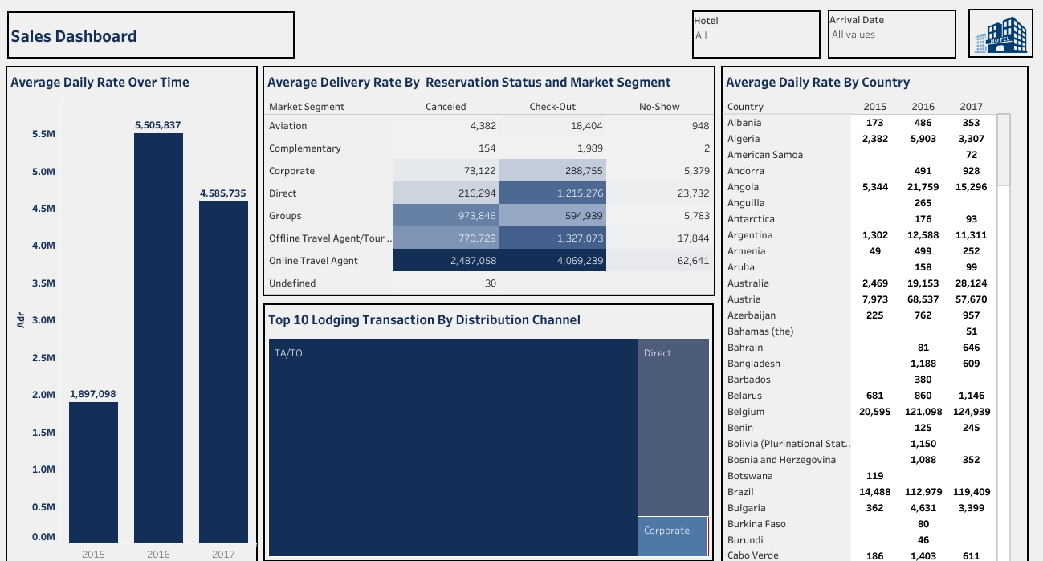

Slide 4
